Slide 1
When Tariffs Disrupt
Global Supply Chains
Supplier
Manufacturer
Supplier Search, Bargaining, and Welfare Costs
Gene M. Grossman , Elhanan Helpman , Stephen J. Redding
Inputs
American Economic Review, 114(4), 988–1029 (2024)
Consumers
汇报人：雷镓恺
汇报时间：2026年10月13日

Slide 2
Contents
01
Motivation & research question
What is new beyond the decline in imports from China?
02
Model: search & bargaining
Why supplier relationships are costly to replace.
03
Tariff shocks & sourcing responses
Small versus large tariffs; thresholds for reorganization.
04
Welfare, calibration & robustness
How the model is disciplined by trade facts.
05
Critical assessment & China extension
What the paper shows—and what it does not show.
02

Slide 3
OVERVIEW
The core question
Tariffs change more than import prices: they may disrupt existing firm-to-firm supply relationships.
Research question
Mechanism
Economic consequences
How do existing supplier relationships adjust after an unexpected input tariff?
How do search, match quality, and bargaining determine whether a firm retains or replaces a supplier?
How do reorganization costs affect input costs, terms of trade, and welfare?
Tariff shock
Supplier search
Renegotiation /
replacement
Welfare
Relative costs change
Outside options change
Supply links adjust
Costs and gains combine
The paper’s central insight: supply-chain adjustment is neither frictionless nor costless.
03

Slide 4
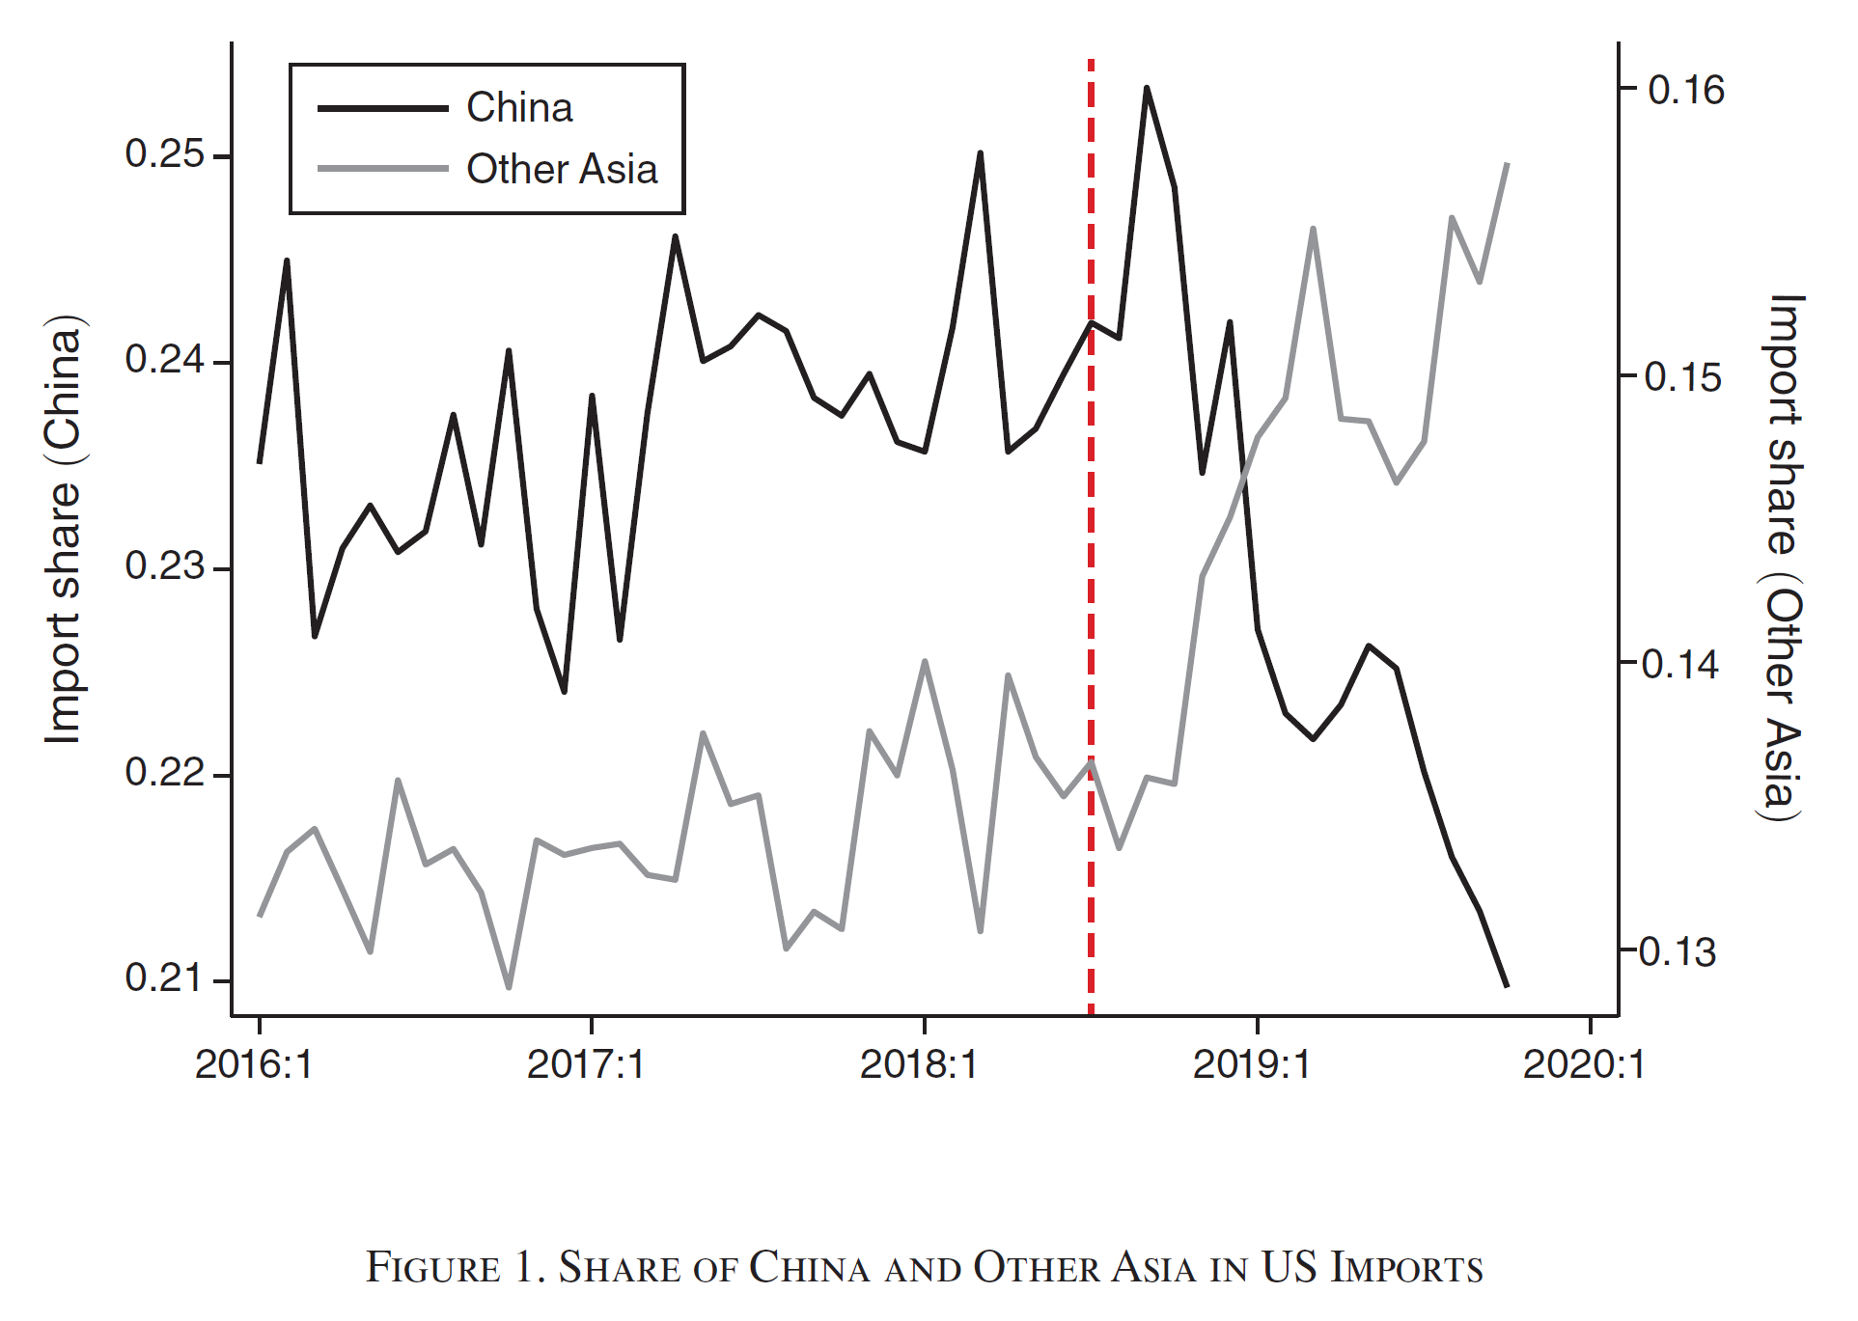
MOTIVATION
Tariffs rose—and sourcing patterns began to change
U.S. import-weighted average tariffs on China, before and after the first Trump tariff waves.
U.S. import-weighted average tariff on China
17.1%
Trade-source changes
After the first tariff wave in July 2018, China’s share of U.S. imports fell while the share of Other Asia increased.
The central puzzle
Is this merely a change in trade flows, or did firms pay costs to rebuild supplier relationships?
2.7%
Import-share changes ≠ supplier-relationship changes
≠ welfare consequences
End-2017
End-2019
04

Slide 5
RESEARCH QUESTION
Research question and literature gap
The paper moves from trade-flow responses to the disruption of firm-to-firm supply relationships.
1
Existing work often asks
2
Gap identified
3
This paper contributes
Global supply-chain participation, the geography of international sourcing, productivity and market structure, and persistent firm-to-firm networks.
“Little attention has been paid to how trade policies might disrupt supply chains and with what implications for consumer prices and welfare.”
A model of costly supplier search, match-specific productivity, and bilateral bargaining to analyze renegotiation, supplier replacement, consumer prices, and aggregate welfare.
Contribution: explain why firms retain, renegotiate, or replace existing suppliers when input tariffs arrive unexpectedly.
05

Slide 6
MODEL
Model environment: why do downstream firms rely on foreign inputs?
Section I builds a standard monopolistic-competition trade model with firm-to-firm supply relationships.
Sector 1: Homogeneous good
Sector 2: Differentiated final goods
Produced with labor alone; its price is the numeraire, normalizing the home wage to one.
Firms use labor and a composite intermediate input and set prices with a markup.
Intermediate inputs
A bundle of differentiated inputs; firms may produce inputs in-house or outsource.
How a supply chain forms
1
2
3
4
5
Enter
Pay search cost
Observe match quality
Accept or search again
Bargain bilaterally
Key assumption: supply chains form in anticipation of free trade; the tariff arrives unexpectedly.
06

Slide 7
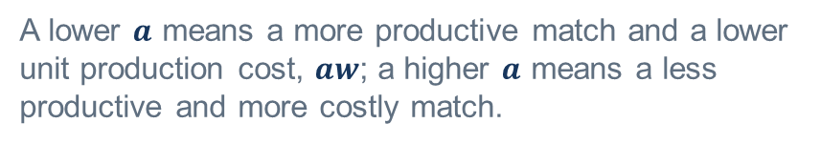








SEARCH
Supplier search: firms do not work with every potential supplier
A match is accepted only if it passes a reservation threshold.
$a$: Inverse match productivity
$a≤\overline{a}$ : Accept
A lower $a$ means a more productive match and a lower unit production cost, $aw$; a higher $a$ means a less productive and more costly match.
The match is good enough; the firm proceeds to bargaining.
$\overline{a}$: Reservation cutoff
$a>\overline{a}$ : Reject
The buyer accepts a match if $a≤\overline{a}$; otherwise, it rejects the match and searches again.
The match is too costly; the firm searches again and incurs additional costs.
$F$: fixed cost per search
$$S\left(\overline{a}\right)=\frac{F}{G\left(\overline{a}\right)}$$
Each attempt uses resources.
Expected total search cost
$G\left(\overline{a}\right)$: probability of an acceptable match
A stricter threshold lowers the chance that a search succeeds.
Trade-off: better supplier matches versus higher search costs.
07

Slide 8



BARGAINING
Finding a supplier is not the end: the price is negotiated
The model uses Nash-in-Nash bargaining: each buyer–supplier pair bargains while other relationships are taken as given.
$$ρ\left(a\right)=βwa+\left(1−β\right)w\overline{a}$$
$β$: the buyer's bargaining weight
A larger β moves the price closer to the current supplier’s cost.
$wa$: the current supplier's unit production cost
$1−β$: the supplier's bargaining weight
$w\overline{a}$: the cost associated with the reservation match
The negotiated price is a weighted average of the current supplier's production cost and the cost associated with the reservation match.
Outside option
Supplier bargaining power
If bargaining fails, the buyer can reject this supplier and search again.
A stronger supplier position moves the price toward the buyer’s reservation cost.
Tariffs change outside options, so prices can change even when supplier identity does not.
The relationship affects both the sourcing decision and the negotiated input price.
08

Slide 9
TARIFF SHOCK
Core result: small and large tariffs trigger different responses
Small tariffs
Large tariffs
• Existing suppliers may retain a cost advantage.
• Firms may retain incumbent relationships.
• Renegotiation changes transaction prices.
• No new search or entry is triggered in the model’s small-tariff region.
• The tariff-inclusive cost of the original source rises.
• New searches shift toward untariffed alternatives.
• Once the critical threshold is crossed, some incumbent relationships are replaced.
A change in the destination of new search does not imply immediate termination of existing supplier relationships.
Supplier reorganization is a dynamic process shaped by thresholds and adjustment costs.
09

Slide 10



THRESHOLDS
Two thresholds: new search versus replacement of incumbents
$τ$ denotes one plus the ad valorem tariff rate.
When the alternative source is more costly, a larger tariff is needed to change sourcing decisions.
$$τ≤\frac{w_{B}}{w_{A}}$$
$$τ>\frac{w_{B}}{w_{A}}$$
$$τ>τ_{C}$$
Original source retains a cost advantage
New searches shift to an untariffed source
Some incumbent relationships are replaced
As tariffs rise, more low-productivity incumbent matches may be replaced—but replacement and search can be more expensive.
10

Slide 11
WELFARE
How do tariffs affect domestic welfare?
The paper decomposes the welfare response into production, input use, and real input costs / terms of trade.
$$V\left(τ\right)= Firm profits + Tariff revenue + Consumer surplus$$
01
02
03
Labor and output
Intermediate-input use
Real input costs and terms of trade
Higher costs affect production scale, labor use, and final-good consumption.
Decentralized bargaining can create a wedge between private marginal cost and social cost.
Substitute-source costs, negotiated prices, and search costs jointly determine welfare.
With tariff revenue rebated domestically, the welfare loss comes from real resource allocation and production changes—not from the transfer itself.
10

Slide 12
EMPIRICAL EVIDENCE
Empirical fact: higher relative tariffs are associated with sourcing shifts
U.S. customs monthly data; source–HTS10–month observations, January 2016–October 2019.
Sample
China imports
Other Asia imports
China imports
Other Asia imports
All goods
All goods
Excl. consumer goods
Excl. consumer goods
Log relative tariffs
−1.713***
+0.339***
−1.538***
+0.259**
Observations
297,980
297,980
183,236
183,236
Regressions include product and month fixed effects; standard errors are clustered at the HTS8 level. The sample includes products with positive imports from both China and Other Asia.
Higher relative tariffs are associated with lower U.S. imports from China and higher imports from Other Asia. The coefficients are log-regression estimates, not percentage-point changes.
These regressions document sourcing responses and motivate the model application; the paper’s welfare result comes from the calibrated structural model.
Grossman, Helpman & Redding (2024) | American Economic Review | Table 1, pp. 990–991
12

Slide 13
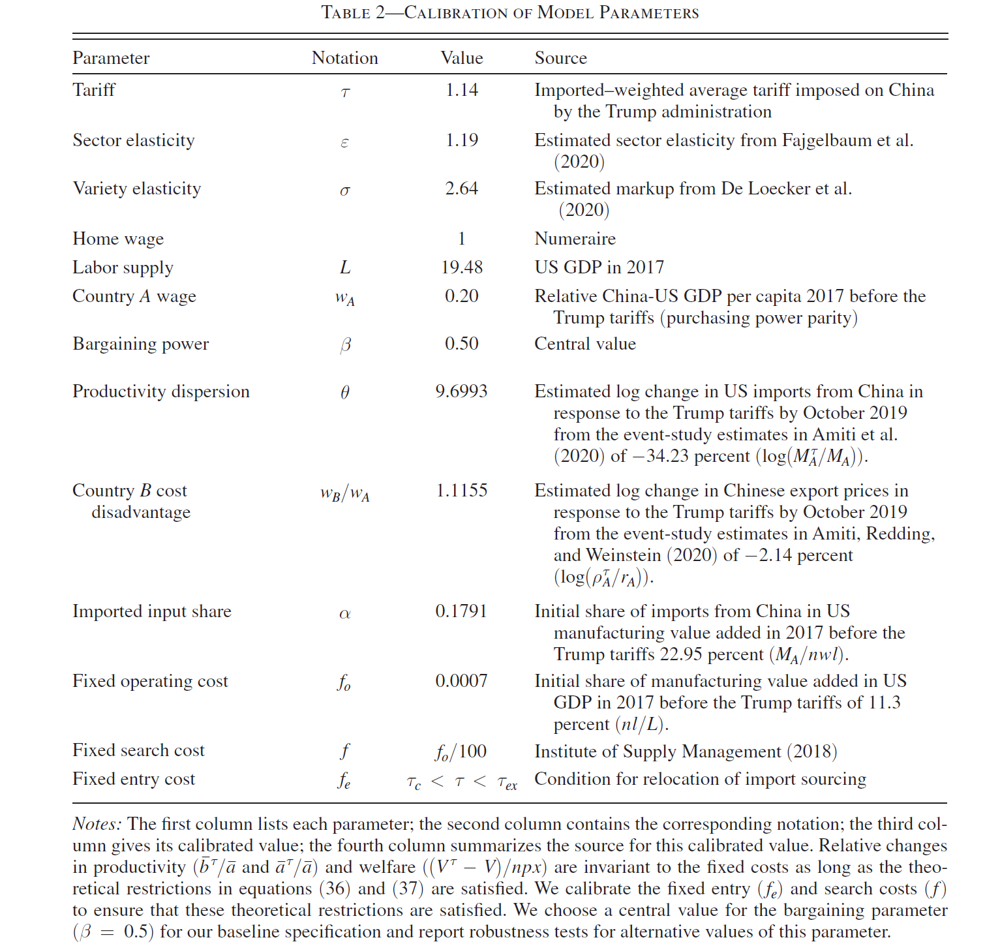

CALIBRATION
How is the model matched to U.S.–China tariff facts?
The model is calibrated to initial import shares and estimated price and quantity responses.
Tariff change
U.S. imports from China
Chinese export price
≈ 14%
Log change ≈ −0.342
Log change ≈ −0.021
Model tariff factor $τ≈$ 1.14
Roughly a 34% decline; calibration target
Roughly a 2% decline; calibration target
Model fit: relative change in import shares (Other Asia versus China)
Observed data
Model prediction
−0.96
−0.64
The model captures the direction and a substantial share of sourcing reallocation, but not every trade movement observed over the period.
13

Slide 14
MAIN RESULT
Main quantitative result: welfare loss of 0.12% of U.S. GDP
The result is a calibrated-model estimate, not a directly observed GDP growth decline.
Partial offset
Main losses
−0.12%
Lower prices from Chinese suppliers offset part of the loss.
Input sourcing shifts toward higher-cost alternatives.
Overall welfare loss
as a share of U.S. GDP
Additional loss
≈ 1.04% of expenditure in the differentiated manufacturing sector
Replacing incumbent supplier relationships requires search expenditures.
Chinese import prices fell by about 2.14%, yet overall U.S. terms of trade deteriorated by 0.45%.
Substantial welfare costs come from changes in input sourcing and search costs.
14

Slide 15
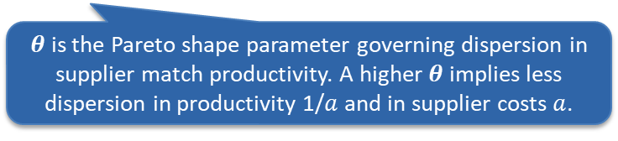

ROBUSTNESS
Robustness: do results depend on one parameterization?
The authors vary key parameters and alternative sourcing scenarios.
Vary match-distribution $θ$
−0.07% to −0.13%
Parameter range
$θ$ is the Pareto shape parameter governing dispersion in supplier match productivity. A higher $θ$ implies less dispersion in productivity 1/$a$ and in supplier costs $a$.
Baseline model
−0.12%
Capital and intermediate goods only
−0.09%
Baseline parameterization
Excludes consumption goods
New supplier relationships are formed in the U.S. rather than in Other Asia
−0.11%
Relocation counterfactual
The welfare effect remains negative in these scenarios, but its magnitude varies with parameters and assumptions.
Robustness within selected scenarios does not validate every possible model specification.
15

Slide 16
CONCLUSION
The paper in three takeaways
The paper explains how unanticipated input tariffs disrupt existing firm-to-firm supply relationships.
1
Question
2
Mechanism
3
Result
How do tariffs disrupt existing firm-to-firm supply relationships?
Search costs, match quality, and bilateral bargaining determine whether firms renegotiate or replace suppliers.
The calibrated model estimates a welfare loss of about 0.12% of GDP; sourcing shifts and search costs contribute substantially.
Key boundary: the paper explains the costs of supply-chain reorganization; it does not directly establish that reorganization improves resilience.
16

Slide 17
EXTENSION
Does supply-chain reorganization necessarily improve resilience?
An extension based on the paper’s scope—not a finding claimed by the authors.
What the paper explains
The paper does not establish
Tariffs change search, bargaining, and sourcing; reorganization creates search and replacement costs.
It does not directly show whether new suppliers help firms recover faster, avoid shutdowns, or reduce price volatility.
Potential research extensions
Does a larger supplier base imply that inputs are genuinely substitutable?
Can short-run search costs buy lower losses in future disruptions?
Should resilience be measured by inventories, shutdowns, sales volatility, delivery times, or recovery speed?
Assessment:
The paper explains the cost of reorganization; its resilience effects remain an open question.
17

Slide 18
CHINA EXTENSION
Applying the mechanisms to China: from tariff exposure to resilience
Potential questions and data sources—not direct implications established by the paper.
Firm level
Value-chain level
Resilience level
Do Chinese exporters diversify destinations, invest overseas, or switch input sources after external tariff shocks?
Does higher third-country exports reflect higher local value added or continued reliance on Chinese inputs?
After supplier concentration falls, do output, delivery times, and sales volatility improve during disruptions?
Potential data sources
Firm annual reports
Customs trade data
Input-output / TiVA
Supplier/customer concentration, overseas operations, risk disclosures.
Product × source country × month import/export adjustments.
Domestic value added and cross-border intermediate-input links.
18

Slide 19
恳请批评指正！
谢谢！

